Slide 1
JMI Laboratories
Machine Learning Project February 2019
S.J. Ryan Arends, PhD
Caitlin Smith, PhD

Slide 2
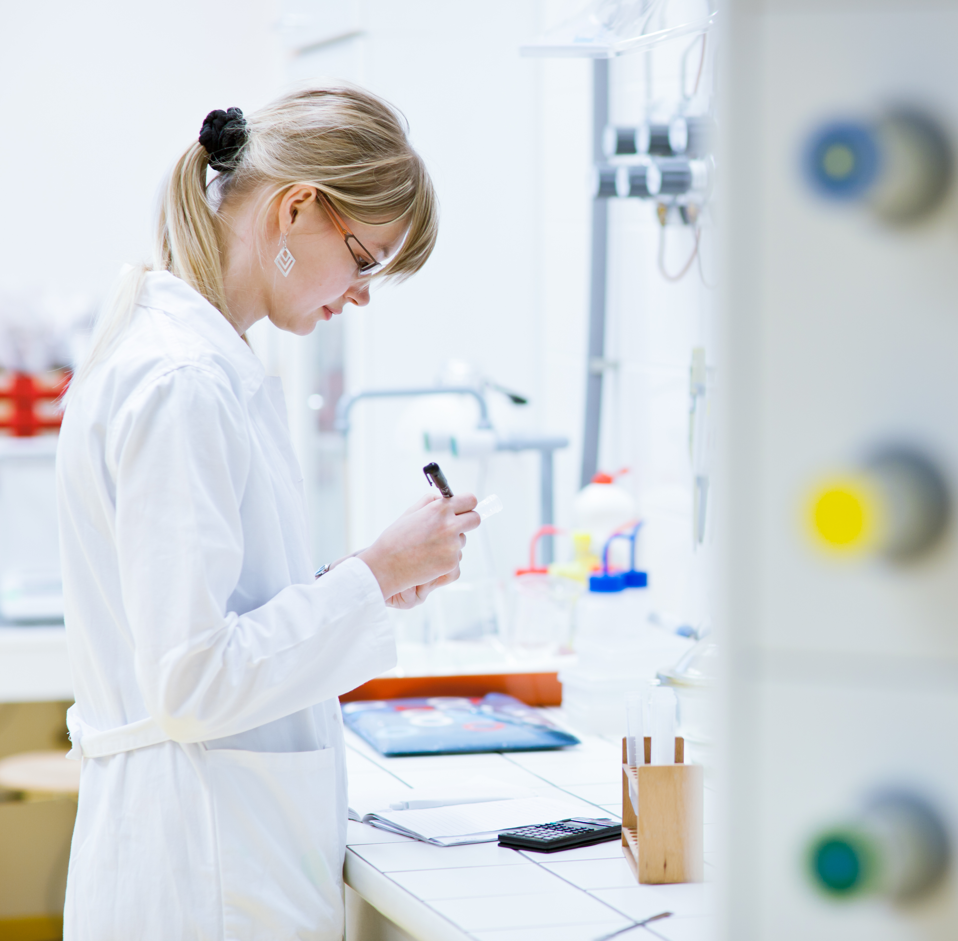
About JMI Laboratories
Founded in 2000 by Dr. Ronald N. Jones
Full-service microbiology and molecular biology laboratories
GCLP compliant, CLIA certified
Located in North Liberty

Slide 3





JMI Services
Surveillance
Drug development
Molecular testing
Clinical trial support
Medical writing
Worked with over 65 pharmaceutical/biotech companies within the last 3 years

Slide 4

SENTRY Surveillance System
20-year program
Monitors antimicrobial resistance and longitudinal trends
Clinical indication-based collection
Monitors the most prevalent pathogens in human-important infections

Slide 5

SENTRY Surveillance System
Consortium-based participation model
Allows for complete or partial inclusion
Geographic, pathogen, or indication specific

Slide 6
SENTRY Surveillance System
Global program – sites in most major markets
North America
Europe
Asia-Pacific
173 sites
45 sites
Australia
30 sites
Latin America
11 sites
14 sites

Slide 7
SENTRY Surveillance System
Bloodstream infection
Invasive Fungal
Community-acquired RTI
Prevalence-based collection objectives
Others
Pneumonia in hospitalized patients
Intra-abdominal infection
Skin and skin structure infection
Urinary tract infection

Slide 8
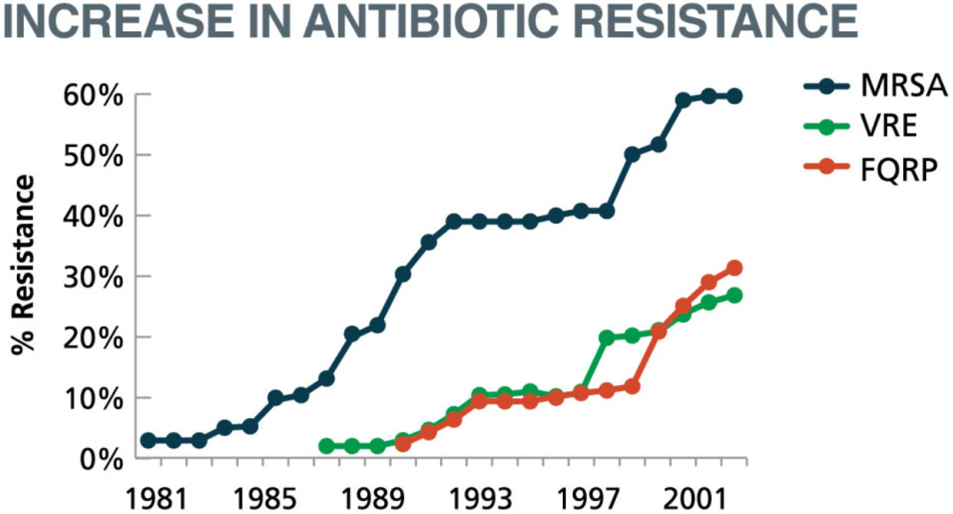
Development of Antibiotics
1930-1940’s
Introduction of Sulfa’s and β-lactams
Resistance will develop with exposure
Limit to proper use

Slide 9
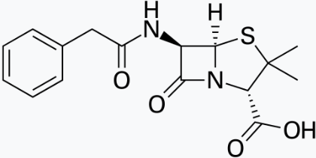
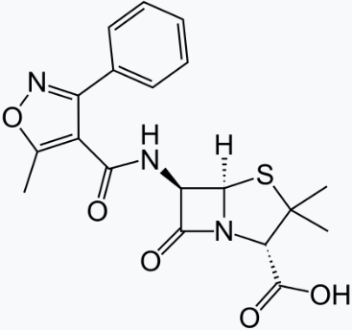
Antibacterial Arms Race
Bacteria
+
=
Bacteria
Resistance
Selection
Bacteria + Resistant Gene
+
=
Bacteria
Next Generation
Antibiotic
Bacteria + Resistant Gene
+
=
Bacteria

Slide 10
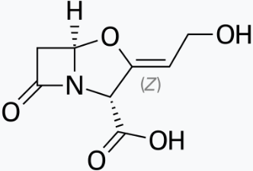
Antibacterial Arms Race
Bacteria + Resistant Gene
+
=
Bacteria
Resistance
Selection
Bacteria + Resistant Gene*
+
=
Bacteria
β-lactamase
Inhibitors
Bacteria + Resistant Gene*
+
=
Bacteria

Slide 11
β-lactams and resistance
β-lactams (BLs):
Penicillins (ampicillin, amoxicillin, piperacillin)
Cephalospoins (cefepime, ceftazidime, ceftaroline)
Carbapenems (doripenem, imipenem, meropenem)
β-lactamase inhibitors (BLIs):
Clavulanic acid, sulbactam, avibactam, tazobactam
Resistance genes:
Extended Spectrum β-lactamase (ESBLs; CTX-M-, SHV-, TEM-)
resistance to penicillins and cephalosporins but not carbapenems
Carbapenem Resistant Enterobacteriaceae (CRE)
often contain carbapenemase (KPC-, IMP-, NDM-, VIM-)
resistance to carbapenems and many penicillins and cephalosporins

Slide 12




Minimum Inhibitory Concentration (MIC)
Smallest amount of a compound that limits visible microbial growth
Dilution series of drug
Inoculate with bacteria
No Cells
No Drug
32 mg/L
16 mg/L
8 mg/L
4 mg/L
2 mg/L
1 mg/L
0.5 mg/L
0.25 mg/L
0.12 mg/L
(-) Control
(+) Control
MIC
MIC for this drug against this bacteria is equal to 2 mg/L

Slide 13
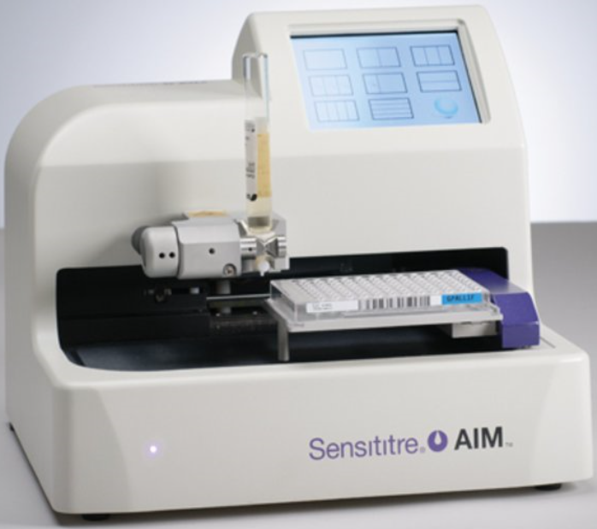
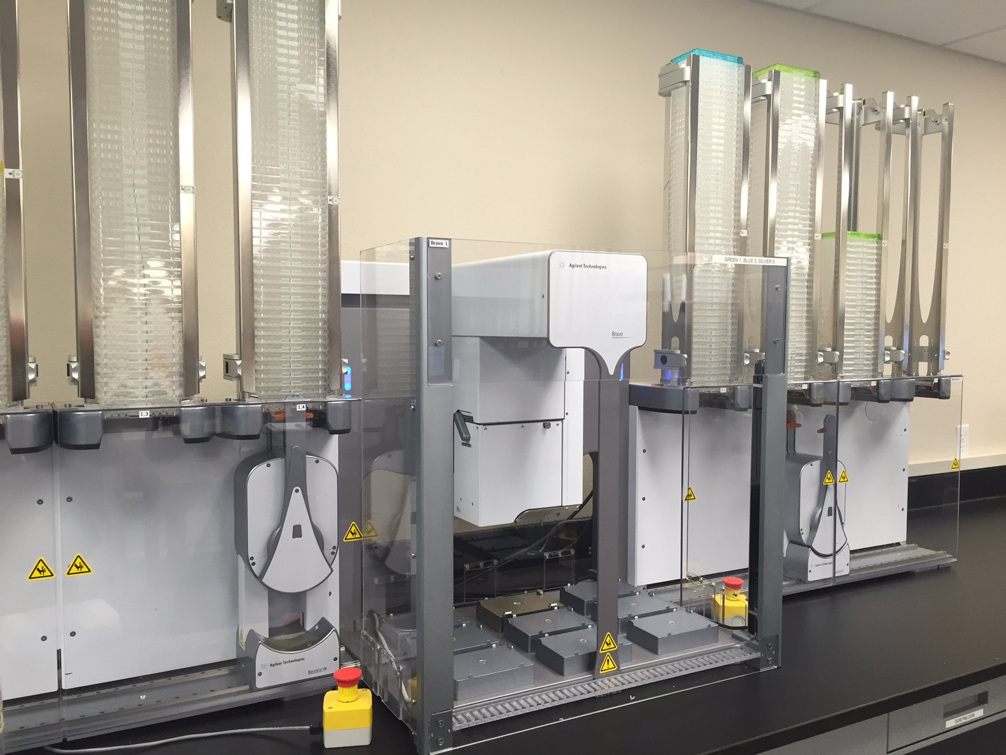
Minimum Inhibitory Concentration (MIC)
Miniaturization and automation
96-well panel
100 µl assay
Robots to put drugs into panels
Robots to put bugs into panels
Over 80,000 panels produced/filled/year
1,349,537 MIC data points

Slide 14
Minimum Inhibitory Concentration (MIC)
Edge Cases
MIC = 2 mg/L
32 mg/L
16 mg/L
8 mg/L
4 mg/L
2 mg/L
1 mg/L
0.5 mg/L
0.25 mg/L
0.12 mg/L
MIC > 32 mg/L
(32.1 raw value)
32 mg/L
16 mg/L
8 mg/L
4 mg/L
2 mg/L
1 mg/L
0.5 mg/L
0.25 mg/L
0.12 mg/L
MIC ≤ 0.12 mg/L
(0.119 raw value)
32 mg/L
16 mg/L
8 mg/L
4 mg/L
2 mg/L
1 mg/L
0.5 mg/L
0.25 mg/L
0.12 mg/L

Slide 15
Susceptible/Intermediate/Resistant (S/I/R)
Breakpoints
Established by regulatory agencies (CLSI in US)
Consider many factors including MIC data
Related to clinical outcomes
Help clinicians determine course of treatment
Antimicrobial Agent | Susceptible (S) | Intermediate (I) | Resistant (R)
Ampicillin | ≤8 | 16 | ≥32
Ciprofloxacin | ≤0.25 | 0.5 | ≥1
Trimethoprim-sulfamethoxazole | ≤2 | - | ≥4

Slide 16
Whole genome sequencing (WGS)
Determine the complete DNA sequence of an organism
JMI developed pipeline for resistance genes
Checks sequences against a list of over 3,000 curated genes
4 terabytes of data last year

Slide 17

Project Overview
Objective:
Investigate associations between beta-lactam resistance genes and beta-lactam resistance using machine learning techniques
Hypothesis:
Genetic profiles consisting of multiple beta-lactamase genes are associated with MICs and resistance categories for beta-lactam drugs.

Slide 18
Questions?

